Slide 1
GeoPose SWG Meeting #148
July 4, 2025

Slide 2
Agenda
Duration | Item
5 min | Opening: Administrivia, Recording, Patent Call
5 min | Upcoming meetings and 2025 events
10 min | Results of Cesium Developer Conference in June in Philly
5 min | Reality (M) Language – next steps?
15 min | Results of June 27 GeoPose Workshop
15 min | Updates from GeoPose WPs leaders - WP 5 Time Coordinates - WP 7 Uncertainty - WP 8 Metaverse Standards Forum (MSF) Prototype Support
5 min | Preparation for October 27 GeoPose Summit
Copyright © 2025 Open Geospatial Consortium

Slide 3
Upcoming SWG Meetings
Date @10 AM Eastern | Purpose/Topic
Rest of July | BREAK
August | BREAK
September 12 | Status updates – Scheduled
September 26 | Status updates – Scheduled
October 10 | Preparation for GeoPose Summit in Boulder
October 17 | Preparation for GeoPose Summit in Boulder
October 27 | GeoPose Summit

Slide 4

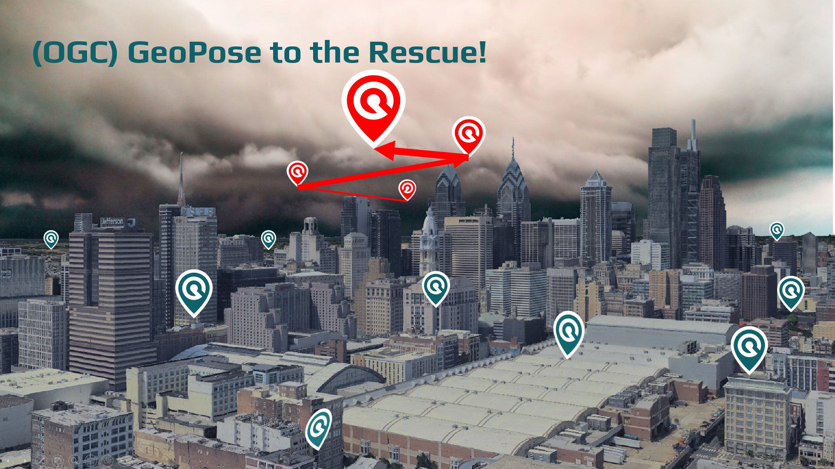
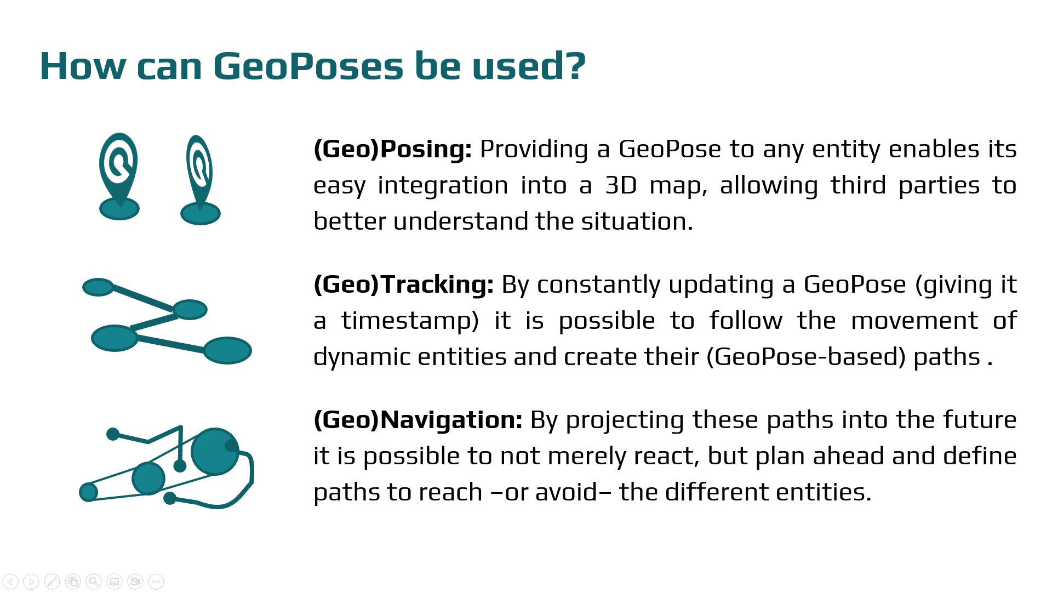
Cesium Developer Conference June 23-25, Philadelphia, USA
Presented GeoPose in a 18 minute talk in the context of Emergency Management.
Not the best presentation (too fast, not shared all the given materials/videos).
The response was positive, but the choice of topic limited the audience to 30-40 people.
Mikel has yet to share the GeoPose implementation on Cesium (see later).
Thanks to everyone who contributed to the presentation/travel.
Copyright © 2025 Open Geospatial Consortium

Slide 5
Implementing OGC GeoPose
After previewing the GeoPose implementation on the CesiumJS Engine to a few attendees, Mikel gathered that developers prefer the component-based structure rather than the previous target-based approach… but with an important caveat: each one just wants to focus on what they need (and they simply ignore the rest until they find it useful).
Based on that feedback, Mikel has reworked his implementation to reflect this developer mentality. Explained in the following flowchart:
Am I expecting
a GeoPose?
Is there a
(simple) “location”
property?
Is there a
“angles” or “quaternion” property?
Parse YPR Rotation component
Is there any
other property with a component?
Angles
Convert to
a Cartesian transform
I received JSON data
Yes
Yes
Parse GeoPosition component
Quat.
Parse Quaternion Rotation component
No
Yes
No or
Complex CRS
No
Yes
Is there a “$schema” property?
Do I really
care about that component?
No
No
Stop
(Ignore it)
Parse that other
component
Yes
Copyright © 2025 Open Geospatial Consortium

Slide 6
Reality (M) Language
NEXT STEPS? Josh?
PLACEHOLDER

Slide 7
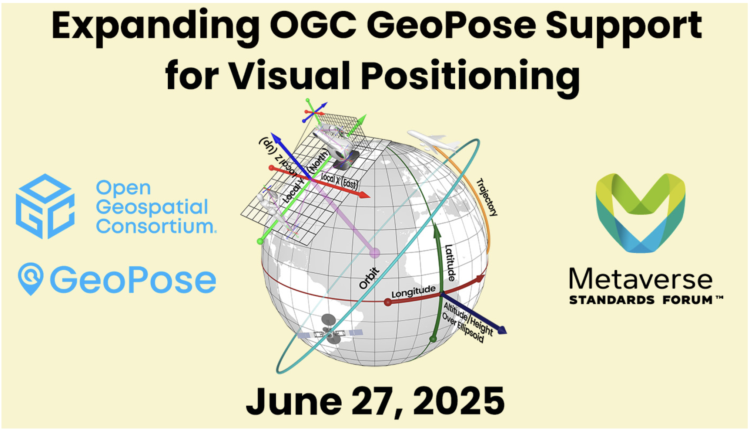

Slide 8
Outcomes
17 registered and approximately 15 people attended
Identified new potential contributor: Pedro Cruz (MeshMap)
Recording with Timestamps was prepared by Forum staff and published on YouTube
Good discussions on all three WPs
Time
Uncertainty
VPS support

Slide 9
Components
A component is a datatype or a class
justified by a use case
conceptually in scope
with a machine-readable schema – I am trying to make JSON-Schema do the job, but I would not yet say that I am winning the battle to avoid starting with UML.
The values of a datatype or properties of a class need required ability to represent whatever it is that they communicate. So JSON Numbers are useless as a specification. I am experimenting with the JSON-Schema “format” property but the AI workers in my toolchain do not yet respect my wishes.
There were twenty-five proposed components in four groups:
Core,
Time Coordinate,
Uncertainty,
Visual Positioning Support

Slide 10
Review of Components by WP
Before: Twenty-five proposed components in four groups. Review by looking a group diagram, then each component in sequence. Discussion embedded in process. About 1 minute of explanation per component.
After: Twenty components:
Core – 4
Time Coordinate – 4
Uncertainty – 4
Visual Positioning Support - 8
These are incorporated into the MSF Visual Positioning Prototypes and will provide some feedback on implementation and practicality in time for the October workshop.

Slide 11
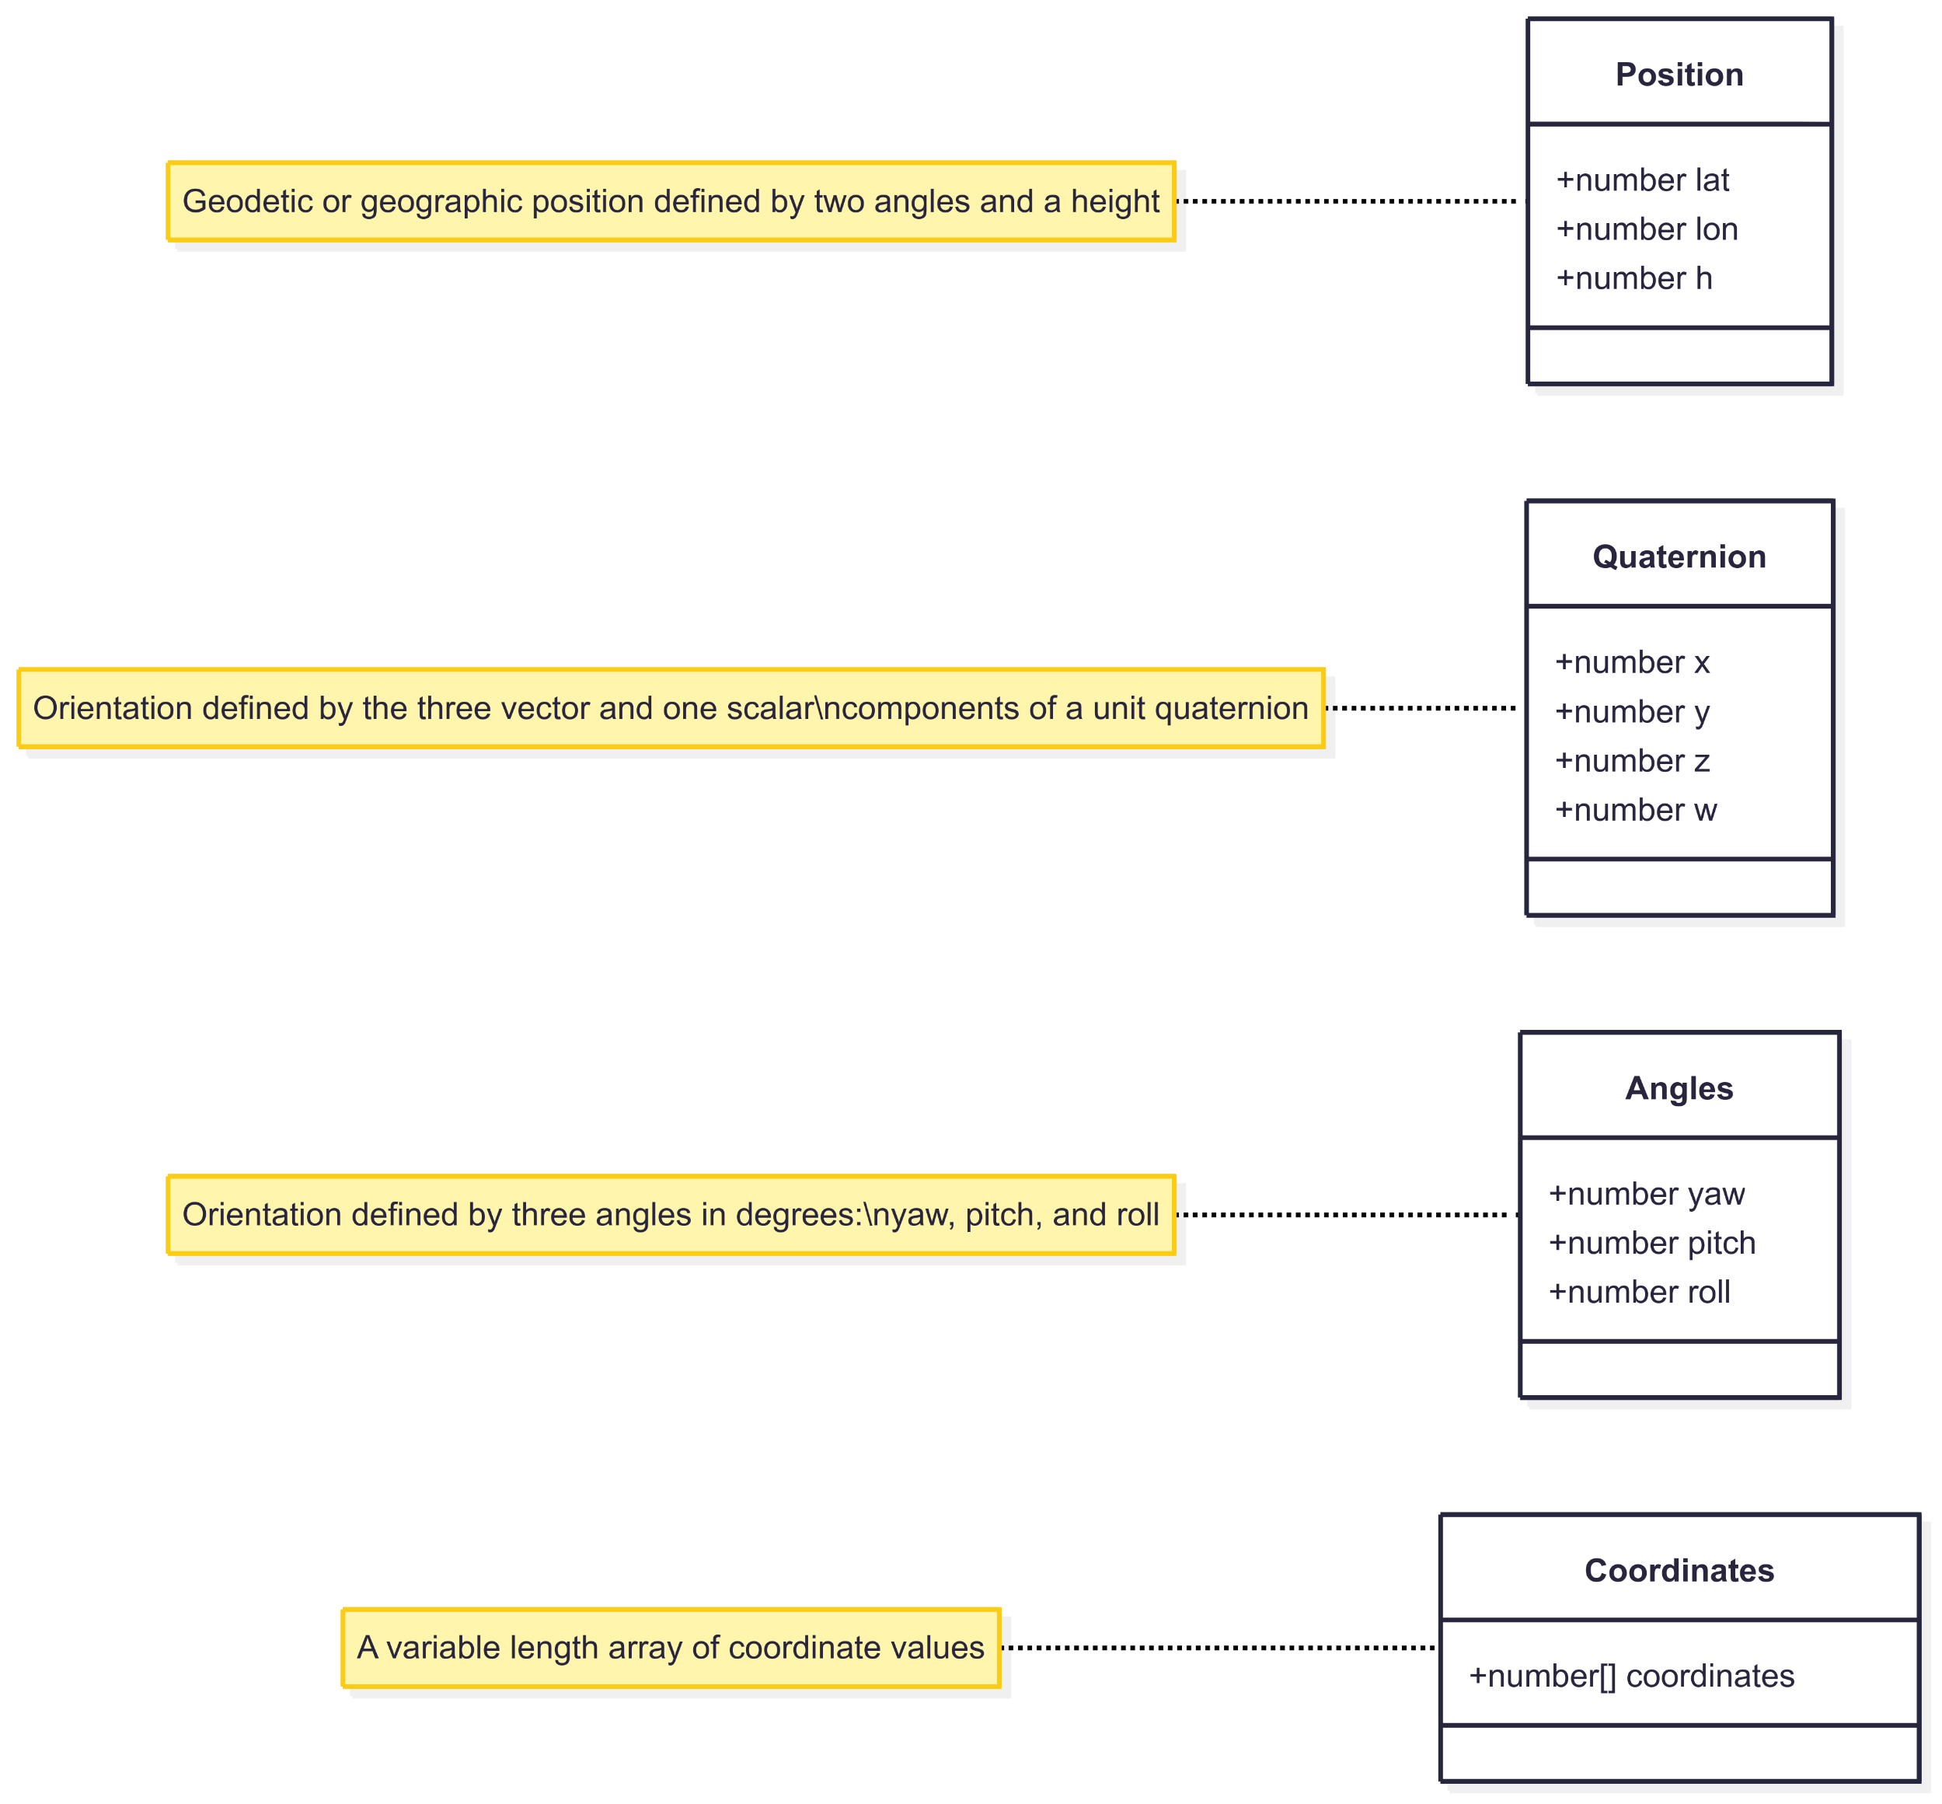
Core Components Before and After
2:20

Slide 12
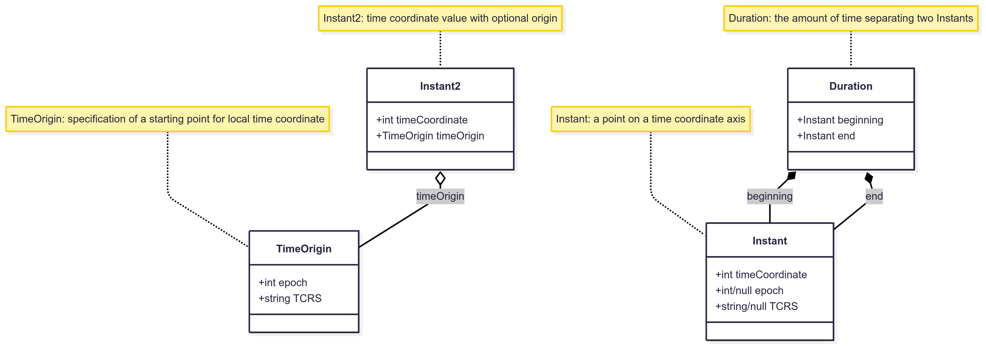




Time Coordinate Components - Before
2:30

Slide 13
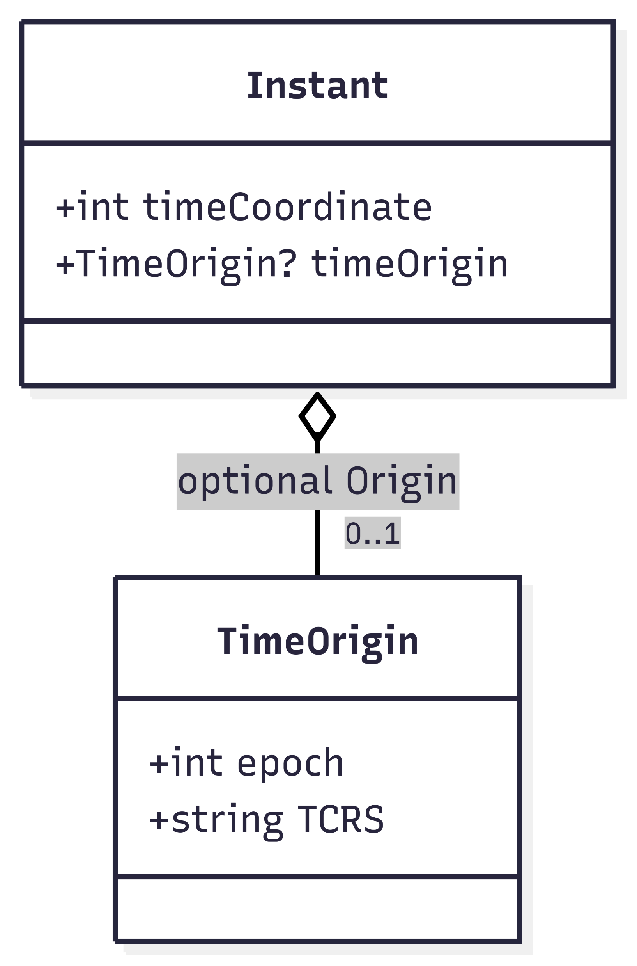
Time Coordinate Components - After
2:30

Slide 14
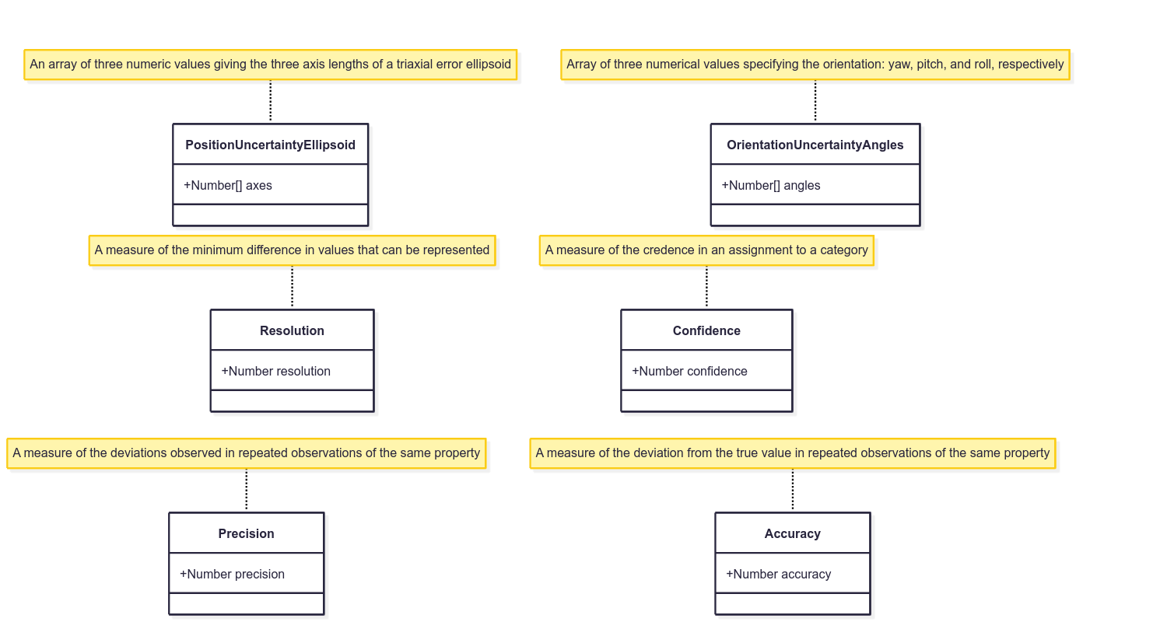
Uncertainty Components - Before
2:40

Slide 15
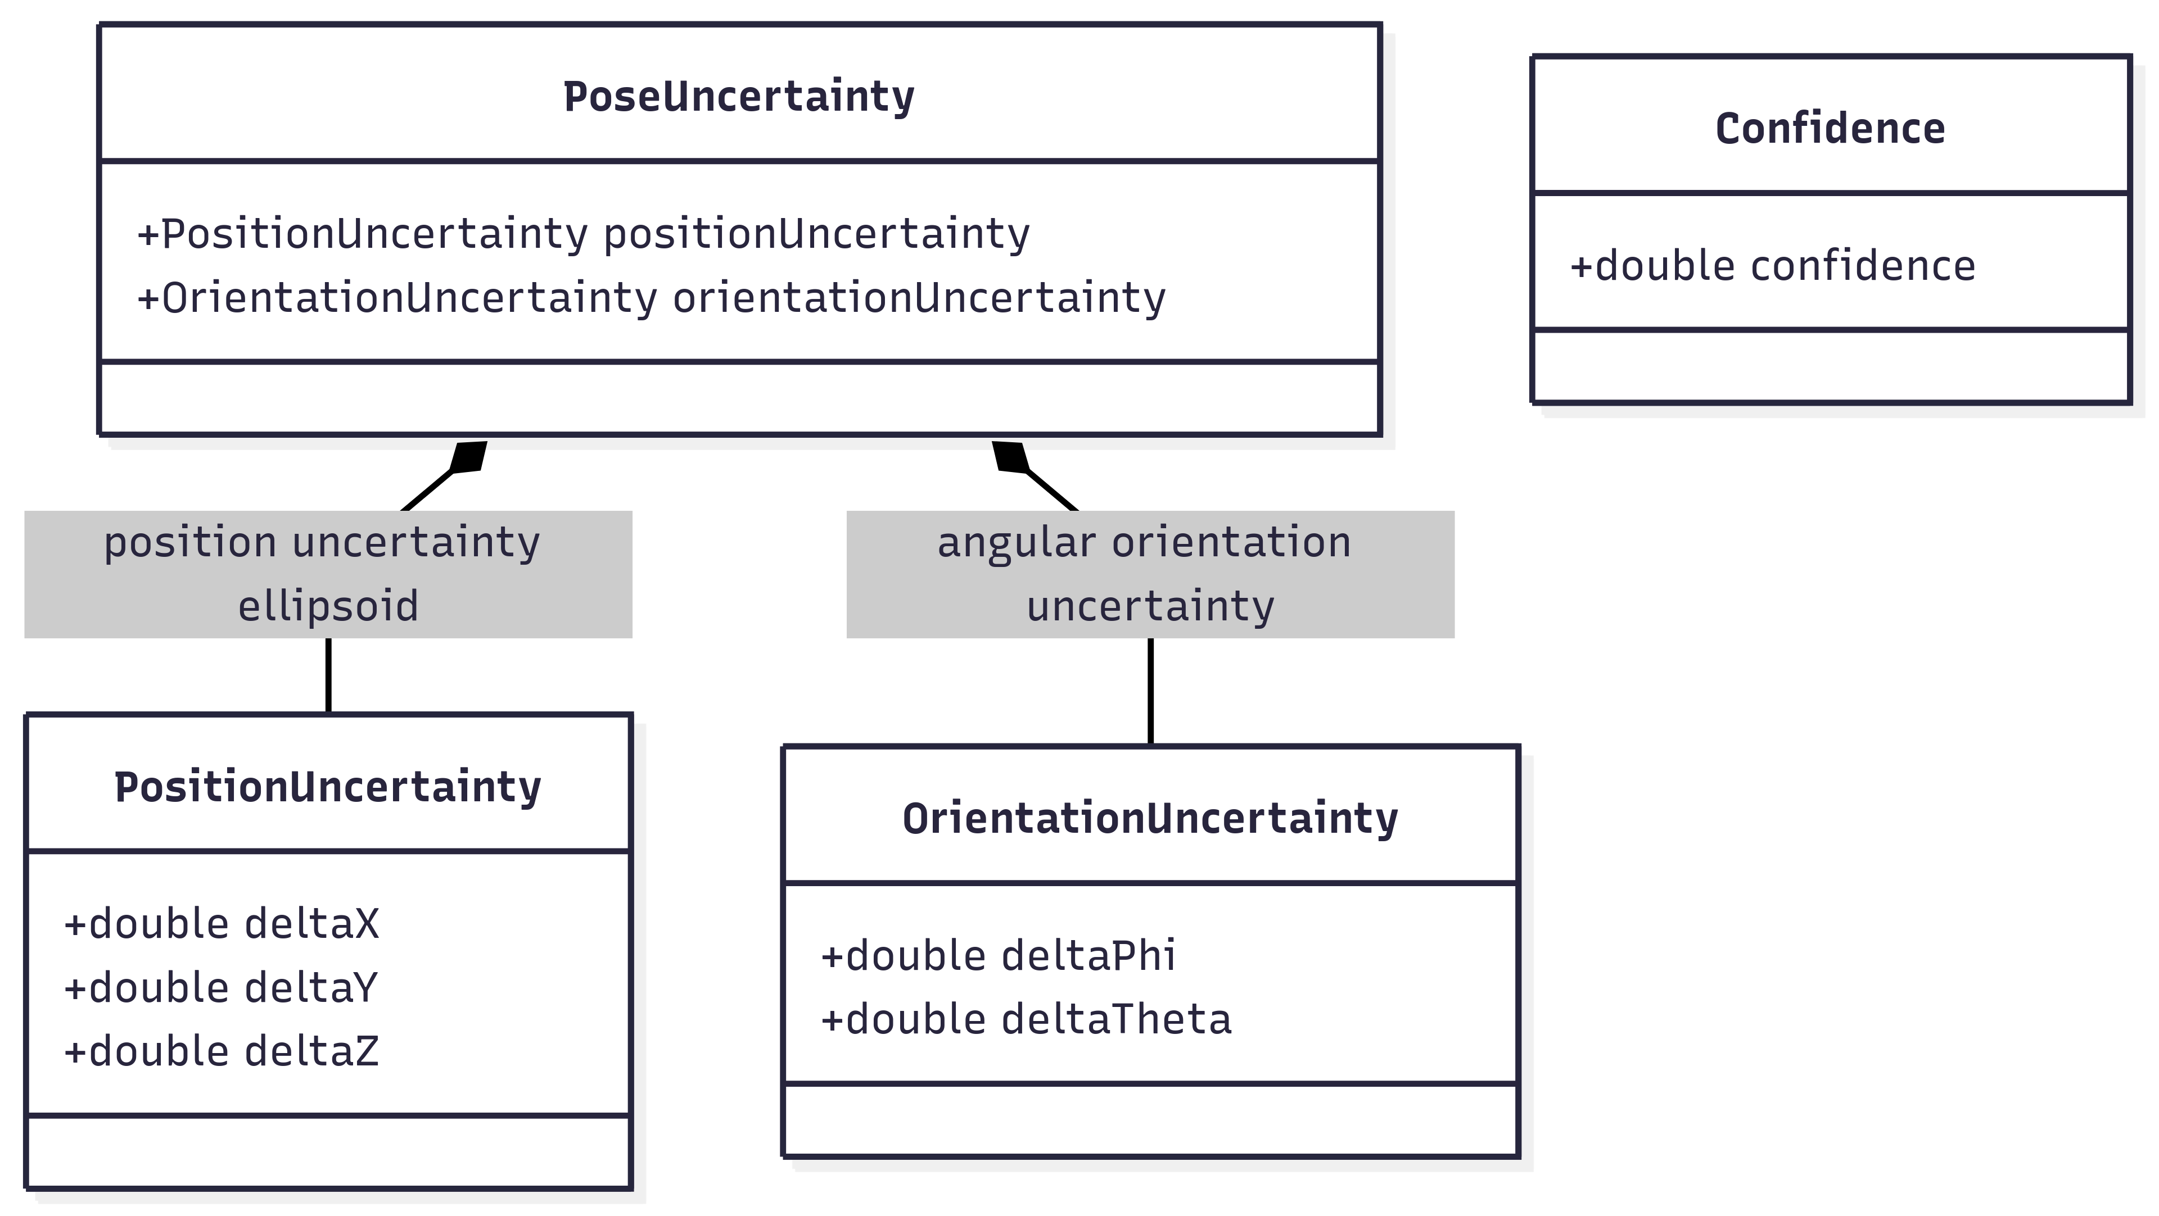
Uncertainty Components - After
2:40

Slide 16
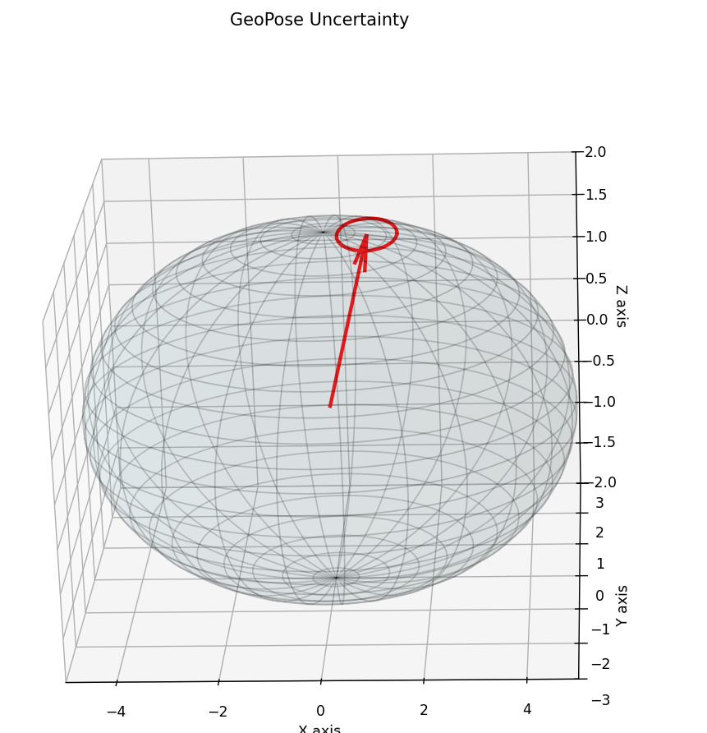
Uncertainty Components – PositionUncertaintyEllipsoid
A 3D position uncertainty ellipsoid, visualizes the spread and orientation of uncertainty around a central point in space. The red arrow indicates the mean (expected) position, and the ellipsoid's shape and orientation are derived from the covariance matrix, representing positional variance in all directions.

Slide 17
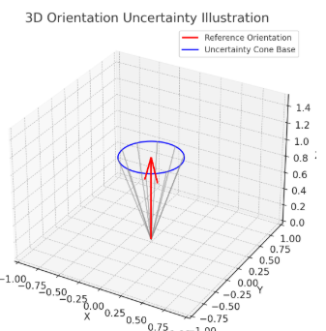
Uncertainty Components – OrientationUncertaintyAngles
Here is a 3D illustration of orientation uncertainty. The red arrow represents the reference orientation, and the blue circle and gray lines form a cone showing possible deviations within a 20-degree uncertainty range. This captures the idea that the orientation could point in any direction within the cone’s spread.

Slide 18
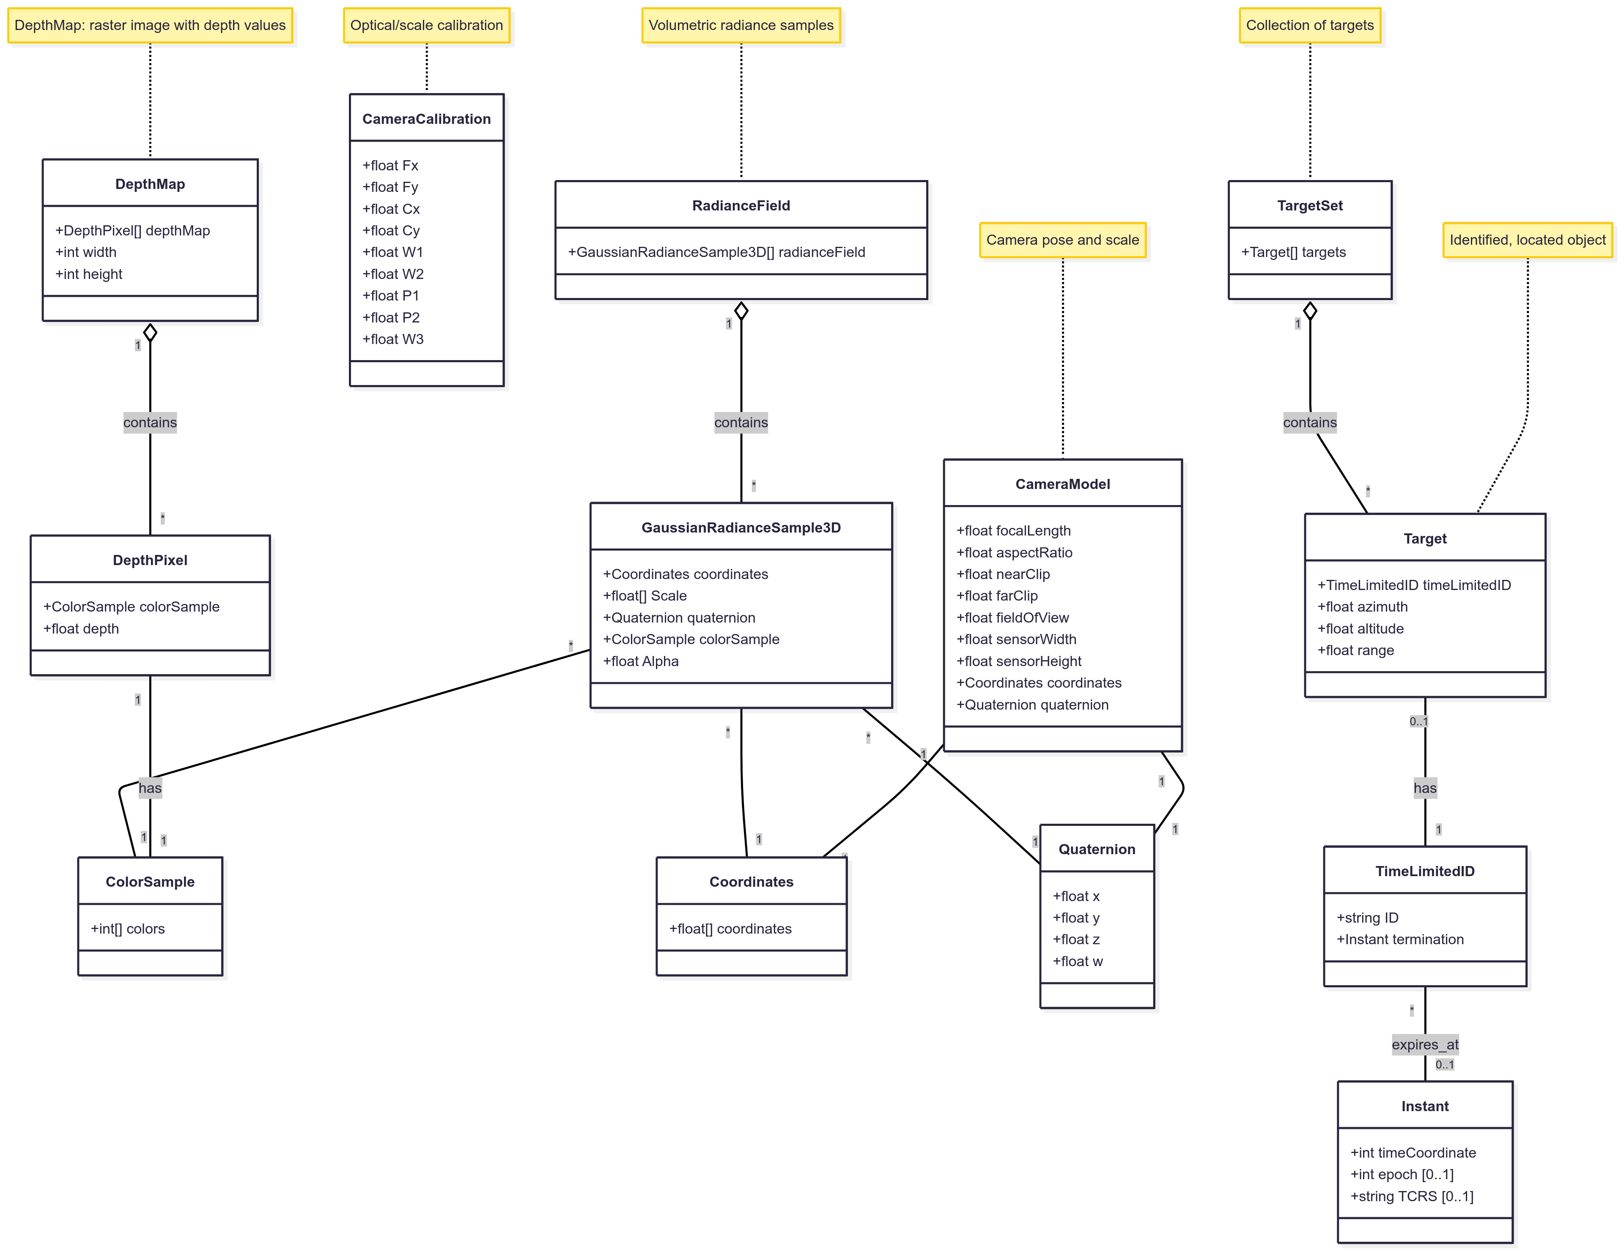
Image Element Components – Before and After (Mostly from OSCP GeoPose Protocol)

Slide 19
GeoPose 1.X Status
NEXT STEPS?
WP1 and 2 Decoupling of JSON Encoding and Conceptual Model
Definition of GeoPose Components and Componetized GeoPose
Developing 25-008 and 25-009 in repositories
What are “GeoPose Components?”
WP 5 Time Coordinates (see next slide)
WP 7 Uncertainty
See Feb 20 proposal especially slides 5, 6, and 7 with regard to some issues raised by Jim A.
Voice concerns/support as soon as possible
There was a meeting on this topic on Tuesday May 20
WP 8 Support for MSF Real Virtual World Integration Prototype: RideHailing use case (using Hillyfields Data Bubble)
Please refer to MSF slides on RFMS for details
Getting “deep images” from OpenEXR
Will work on this during next (2nd May) meeting
Copyright © 2025 Open Geospatial Consortium

Slide 20
WP 1 GeoPose Components & Componentized GeoPose
No Changes in over 60 days
Definition: units of description that are used to compose GeoPose and Standardization Targets
https://github.com/opengeospatial/GeoPose/issues/89
Covers all existing use cases
Fully backward compatible
See more in these slides for WP 1 and these slides for WP 2
Copyright © 2025 Open Geospatial Consortium

Slide 21
GeoPose 1.1 JSON Encoding
MIKEL, ROB SMITH, JIM
This will define JSON Encoding for all GeoPose components
Copyright © 2025 Open Geospatial Consortium

Slide 22
WP5: Time Questions -> See Proposal
NEXT STEPS?
It would probably be a good idea to have a chat about how time integrates with the revised component structure. For example, time sequences may be superseded by the new component approach.
Time as just a coordinate axis, with temporal points in a 1-D sequence..
Issue: How do you specify which axis – temporal CRS? For example, TIA.
Issue: Axes with discontinuities or backwards jumps or stretching and squeezing are probably not good choices.
On a related topic, are GeoPose components designed to be embedded in other formats or extended to encapsulate them, or both?
GeoPose objects are (unordered) compositions of GeoPose components
GeoPose components may be embedded in other formats, where they can be recognized and properly interpreted, using the component name (e.g. “quaternion”) as a key or unique identifier.
We should agree what is in and out of scope for time support in GeoPose 1.x. For instance, should we consider time interpolation - given the spline discussion last week?
My opinion is that time interpolation is out of scope for time but nevertheless interesting and important for some use cases
Do we have a list of identified use cases for timestamped GeoPose? For example, trajectories should probably already be on that list.
Any application where time is used for synchronization between independent platforms
Any application where travel time is a factor in interactions.
Navigation and motion capture would be two concrete ones.

Slide 23
Developing October 27 GeoPose Summit in Boulder
What we will need
Web page (on Forum web site? On OGC? On GeoPose.org?)
Social media
Registration page
Sponsor for meals and coffee breaks
Web page
Current short draft text is on Google Drive here
Although this has yet to go through Steve Smyth’s review (and there will be many improvements!) here is a draft of some more in-depth session descriptions for the October 27 GeoPose Summit in this Google doc.

